Slide 1

Intertemporal choice applications
Notes on Behavioural Economics
Jason Collins

Slide 2


Slide 3
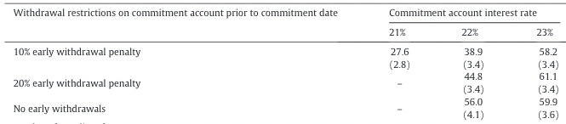
Savings

Slide 4
SEED
28.4% take-up
Average savings balance increased by:
42% after six months
82% after one year.

Slide 5
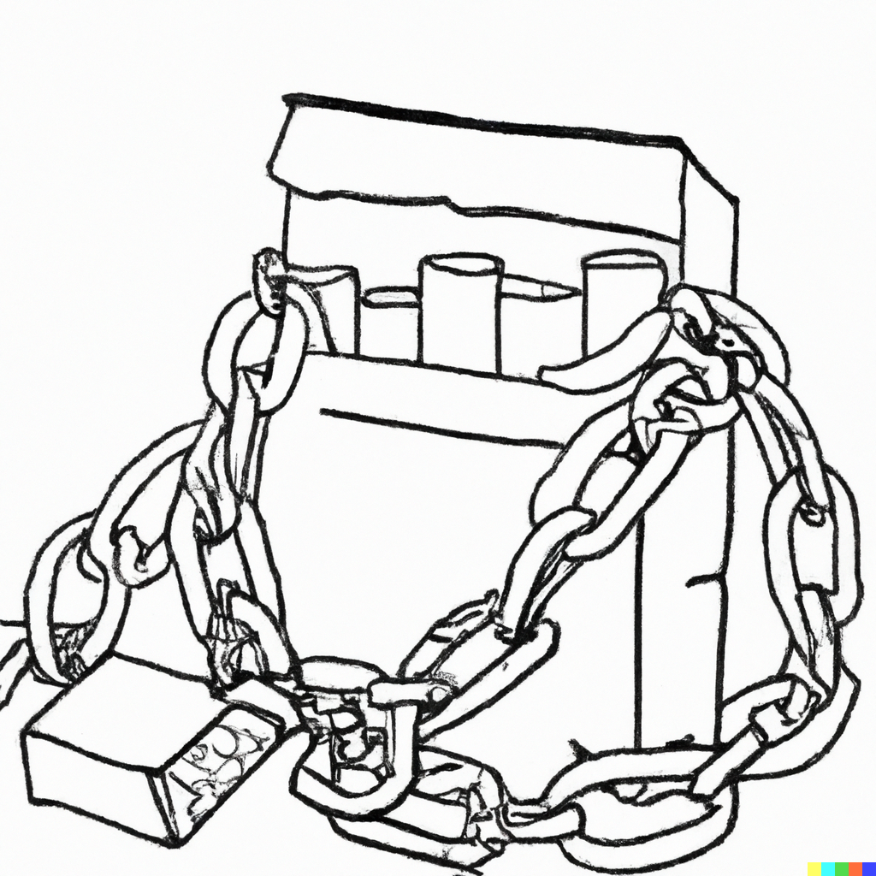

Slide 6
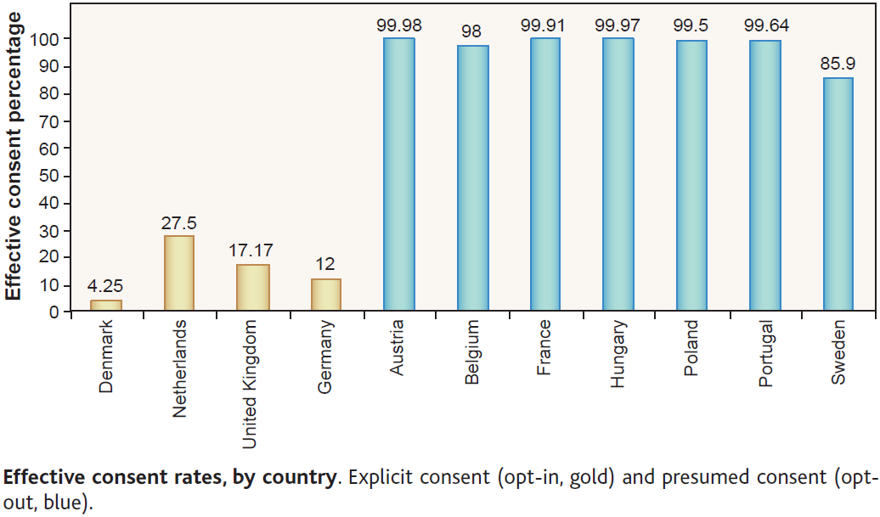
Organ donation
Johnson and Goldstein (2003) “Do Default Save Lives?”, Nature, 302

Slide 7
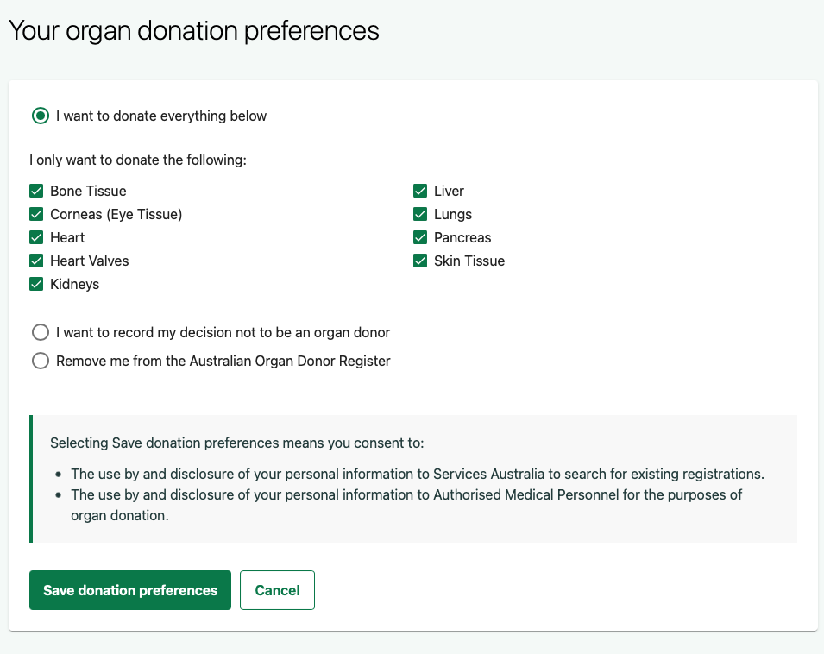

Slide 8
Save More Tomorrow
Customers are asked to commit in advance to allocating a fraction of their future salary increases toward their retirement savings accounts.
Thaler and Benartzi (2004) “Save More Tomorrow™: Using Behavioral Economics to Increase Employee Saving”, Journal of Political Economy, 112, S1: S164-S187

Slide 9
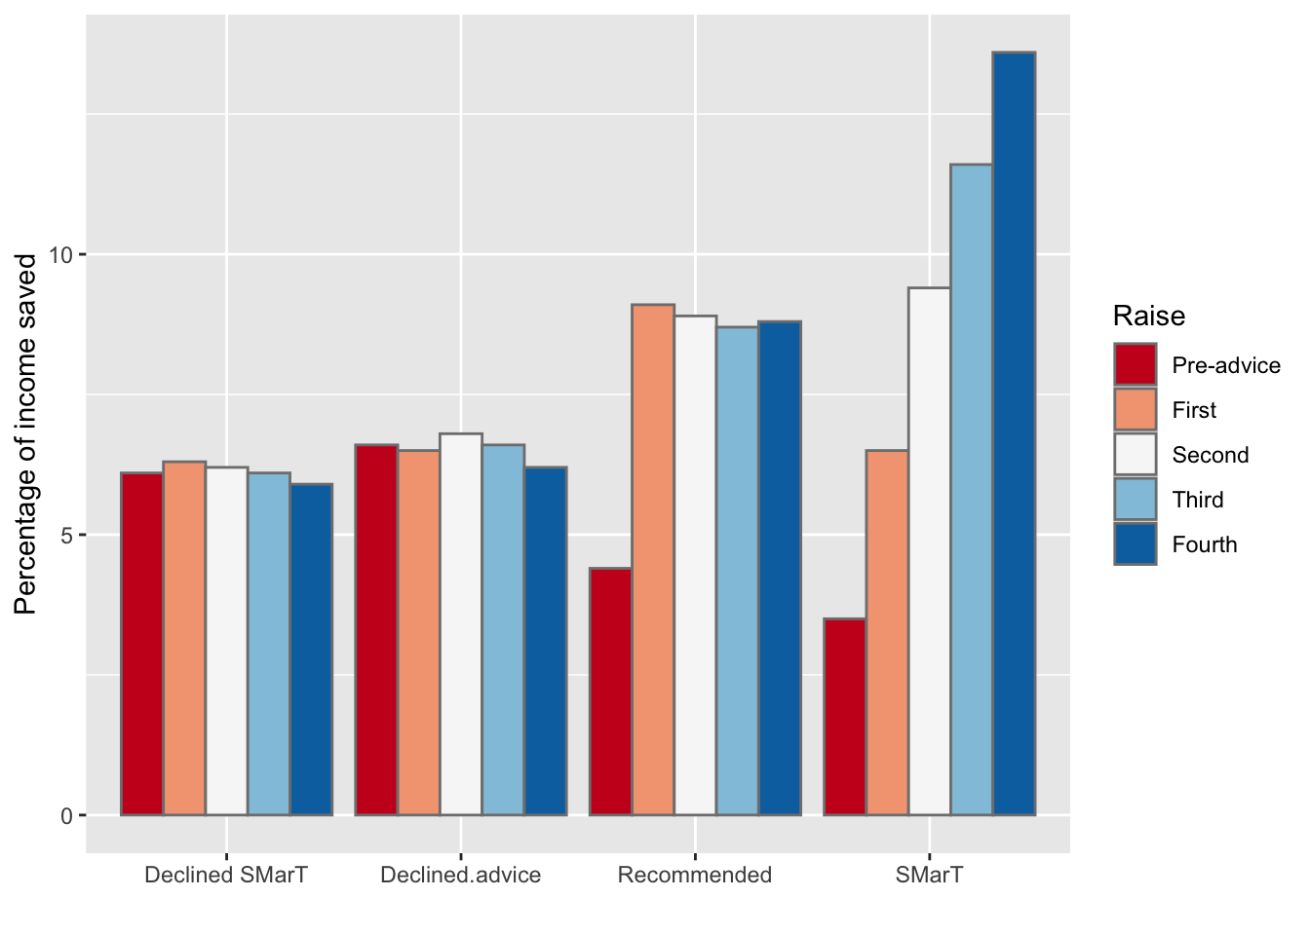
Save More Tomorrow

Slide 10
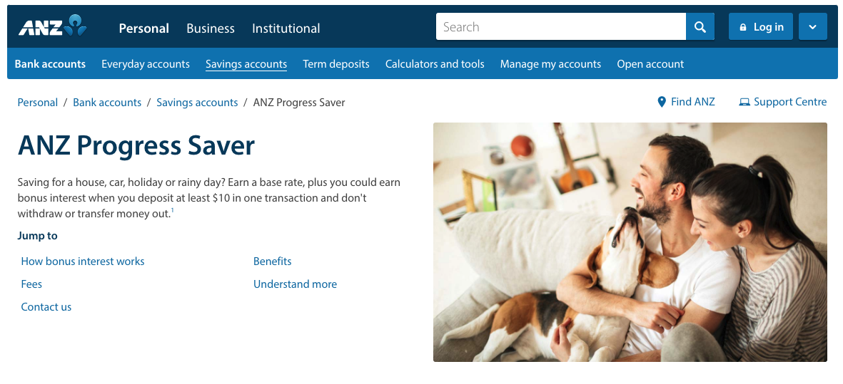

Slide 11
